Slide 1
DEMENTIA PREDICTIVE ANALYSIS
AI Mini Project
{ USING MRI SCANS }
By:
Khushboo Agarwal – PB34
Harshaan Arora – PB41
Hrithvik Ranka – PB48

Slide 2
OBJECTIVE.
This project predicts whether a person, is demented or not. The dataset performing ML has been taken from OASIS-brains.org (Open Access Series of Imaging Studies). OASIS has a collection of datasets on MRI scans taken volunteers. Pre-Processing techniques like handling of missing values, label encoding and other methods have been used. Model Selection is done using k-fold cross-validation. The model we have chosen is the Randomforest Classifier, from the sklearn.ensemble package, to fit the model on the dataset. Prediction is calculated on the scoring method of accuracy, Finally, a user from the doctor’s office enters on the website all the necessary parameters to predict whether a person can be demented or not, providing automated analysis.

Slide 3
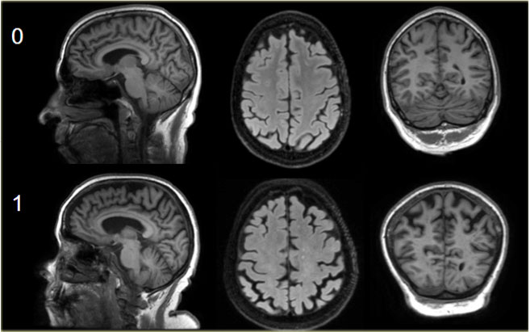
DATASET DESCRIPTION.
This set consists of a longitudinal collection of subjects aged 60 to 96. The subjects are all right-handed and include both men and women. 72 of the subjects were characterized as nondemented throughout the study. 64 of the included subjects were characterized as demented at the time of their initial visits and remained so for subsequent scans, including 51 individuals with mild to moderate Alzheimer’s disease. Another 14 subjects were characterized as nondemented at the time of their initial visit and were subsequently characterized as demented at a later visit.

Slide 4
ATTRIBUTES OF DATASET.
SES : Social Economic Status.
(range is from 1 = Rich to 5 = Poor)
MMSE : Mini Mental State Examination Score
(range is from 0 = worst to 30 = best)
AGE : 60 - 96 y/o
CDR : Clinical Dementia Rating.
(range is from 0 = best to 2 = worst)
ASF : Atlas Scaling Factor.
eTIV : Estimated Total Intra-Cranial Volume.
nWBV : Normalised Whole Brain Volume.
Gender : M / F
Education : Number Of Years of Study.
Hand : R / L
Visit : Number of Visits to the Doctor.
MR Delay : Delay b/w visits.

Slide 5
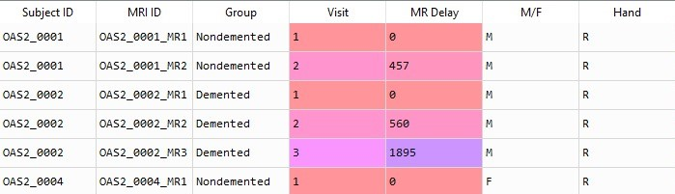
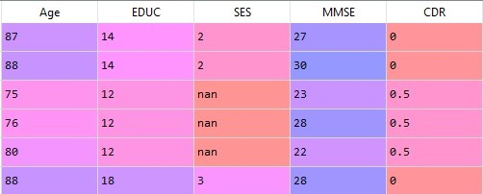
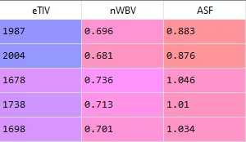

Slide 6
DATA CLEANING & PRE-PROCESSING.
import pandas as pd
import numpy as np
import seaborn as sns
oasis_long = pd.read_csv('oasis_longitudinal.csv')
oasis_long = oasis_long.drop(columns = ['Hand', 'MRI ID', 'MR Delay', 'Subject ID', ‘Visit’])
X["M/F"].fillna("M",inplace = True)
X["Age"].fillna(method='ffill',inplace=True)
X["EDUC"].fillna(method='ffill',inplace=True)
X["CDR"].fillna("0",inplace = True)
X["eTIV"].fillna(method='ffill',inplace=True)

Slide 7
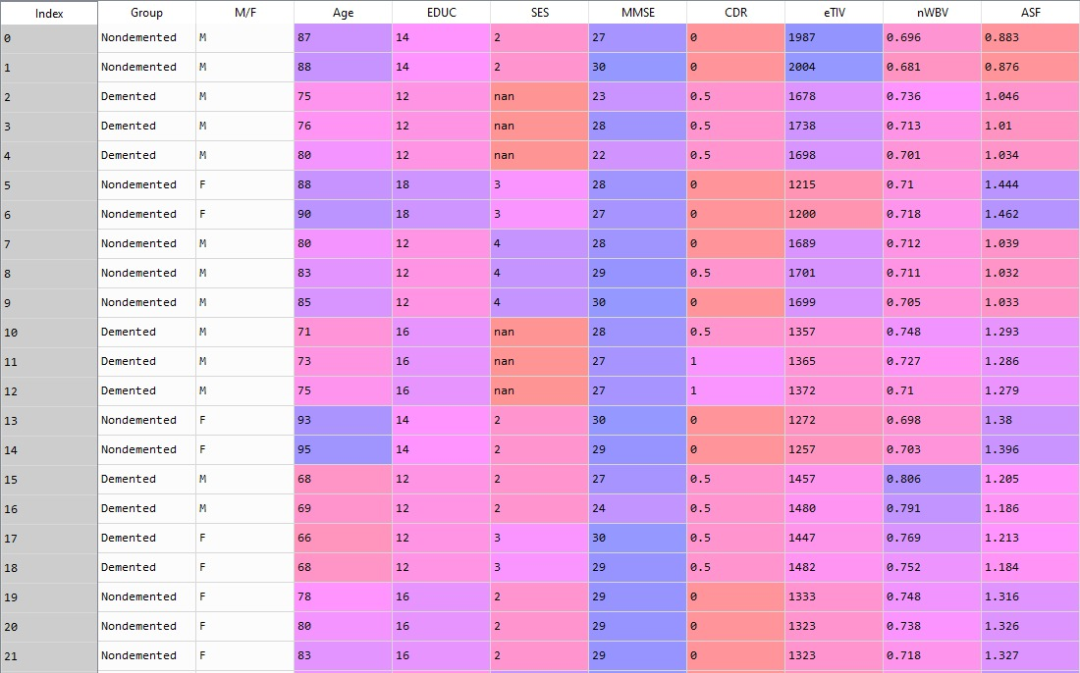

Slide 8
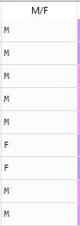
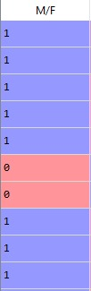
LABEL ENCODING :
.ASTYPE()
GENERAL LABEL ENCODING
y = oasis_long['Group'].astype('category')
X = oasis_long.iloc[:, 1:]
X1 = X
from sklearn.preprocessing import LabelEncoder
le = LabelEncoder()
X.iloc[:, 0] = le.fit_transform(X.iloc[:, 0])

Slide 9
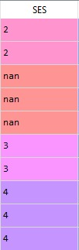
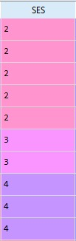
HANDLING MISSING VALUES : NaN VALUES
from sklearn.impute import SimpleImputer
imputer_SES = SimpleImputer(missing_values=np.nan, strategy='median')
imputer_MMSE = SimpleImputer(missing_values=np.nan, strategy='mean')
X.iloc[:, 3:4] = imputer_SES.fit_transform(X.iloc[:, 3:4])
X.iloc[:, 4:5] = imputer_MMSE.fit_transform(X.iloc[:, 4:5])

Slide 10
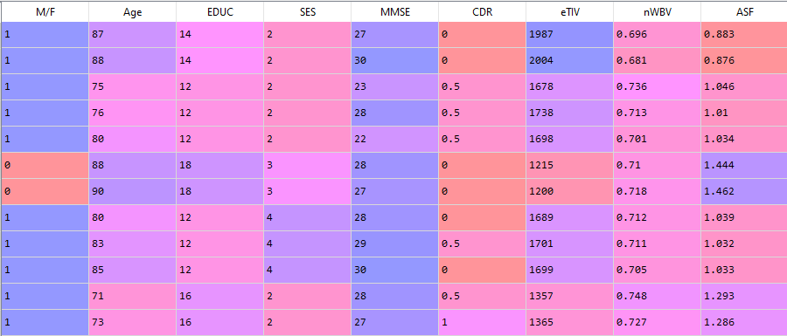

Slide 11
MODEL SELECTION :
from sklearn.ensemble import RandomForestClassifier
from sklearn.neighbors import KNeighborsClassifier
from sklearn.linear_model import LogisticRegression
from sklearn.naive_bayes import GaussianNB
from sklearn.svm import SVC
from sklearn.model_selection import cross_val_score
results = []
names = []
accuracy_score = {}
for name, model in models_list:
cv_results = cross_val_score(estimator = model, X = X, y = y,
cv=10,scoring='accuracy', n_jobs = -1)
results.append(cv_results)
names.append(name)
print( "%s: %f " % (name, cv_results.mean()))
models_list = []
models_list.append(('LOG', LogisticRegression()))
models_list.append(('RFC', RandomForestClassifier()))
models_list.append(('SVM', SVC(gamma = 'scale')))
models_list.append(('NB', GaussianNB()))
models_list.append(('KNN', KNeighborsClassifier()))

Slide 12
ACCURACY :
LOG: 0.946750
RFC: 0.914126
SVM: 0.742391
NB: 0.937115
KNN: 0.574954

Slide 13
LOGISTIC REGRESSION
from sklearn import linear_model
log_reg = linear_model.LogisticRegression(penalty=‘12')
log_reg.fit(X,y)
y_pred_log1 = log_reg.predict(Pred_Form1)
return y_pred_log1

Slide 14
RANDOM FOREST
from sklearn.ensemble import RandomForestClassifier
rf = RandomForestClassifier(n_estimators = 50, criterion = 'entropy', bootstrap= True, max_features = 'auto’)
rf.fit(X, y)
y_pred1 = rf.predict(Pred_Form1)
return y_pred1

Slide 15
GAUSSIAN NAÏVE BAYES
from sklearn.naive_bayes import GaussianNB
GB = GaussianNB()
GB.fit(X,y)
y_pred_GB1 = GB.predict(Pred_Form1)
return y_pred_GB1

Slide 16
THANK YOU !

